Slide 1
The Role of Risk Analysis in Corporate Finance Day 4 Program Materials

Slide 2
Table of Contents
Anglo American Aggregates: Classroom Discussion.......................................................3
Anglo American Aggregates: Financial Profile and Projections....................................10
Anglo American Aggregates: Industry and Business Risk.............................................15
Anglo American Aggregates: Management’s Agenda..................................................24
Financial Buyer: Lloyds Private Equity Partners...........................................................27
Acquisition Analysis: Lloyds Private Equity Partners as Financial Buyer......................30
Lloyds Private Equity Partners: Discounted Cash Flow Valuation.................................52
Strategic Buyer: Hanson Trust.......................................................................................66
Acquisition Analysis: Hanson Trust as Strategic Buyer..................................................69
Jake Stone and the Team: The Choice...........................................................................86
Appendix 1: Use of Excel (WACC of 9.60%): Anglo American Aggregates....................89
Appendix 2: Use of Excel (WACC of 8.45%): Anglo American Aggregates....................95

Slide 3
Anglo American Aggregates Classroom Discussion

Slide 4
Identify the key industry and business value drivers which impact the aggregates industry in general, and AAA’s position in the industry in particular.

Slide 5
Using the Exhibits to the AAA Case, review AAA’s financial performance over the period 2020 – 2025, identify the key metrics of its financial performance, and evaluate how well management has run the business over this period.

Slide 6
Using the Exhibits to the AAA Case, review AAA’s projected financial performance over the period 2026 – 2033, identify the implications of these projections on the financial profile and capital needs of AAA over the next seven years.

Slide 7
As you consider Mr. Stone’s personal and professional agenda, identify choices facing him and the types of solutions which Lloyds Private Equity Partners could recommend in helping him to achieve him objectives.

Slide 8
Anglo American Aggregates Financial Profile and Projections

Slide 9
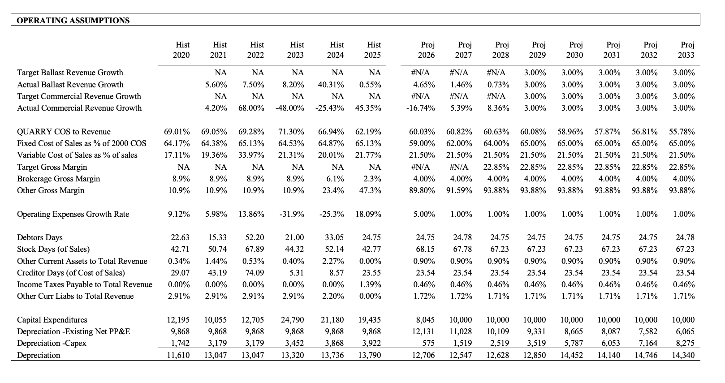

Slide 10
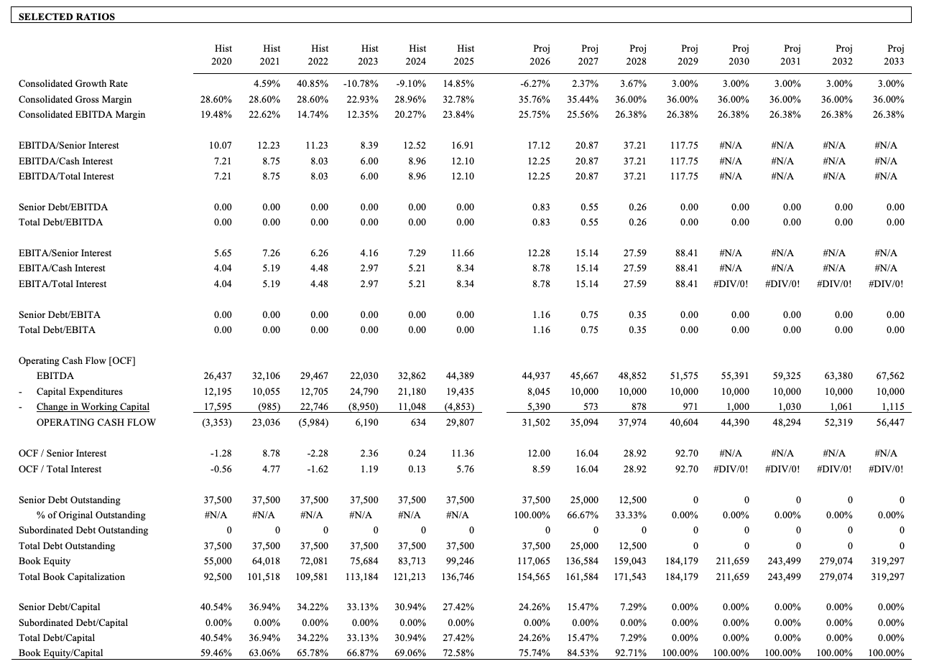

Slide 11
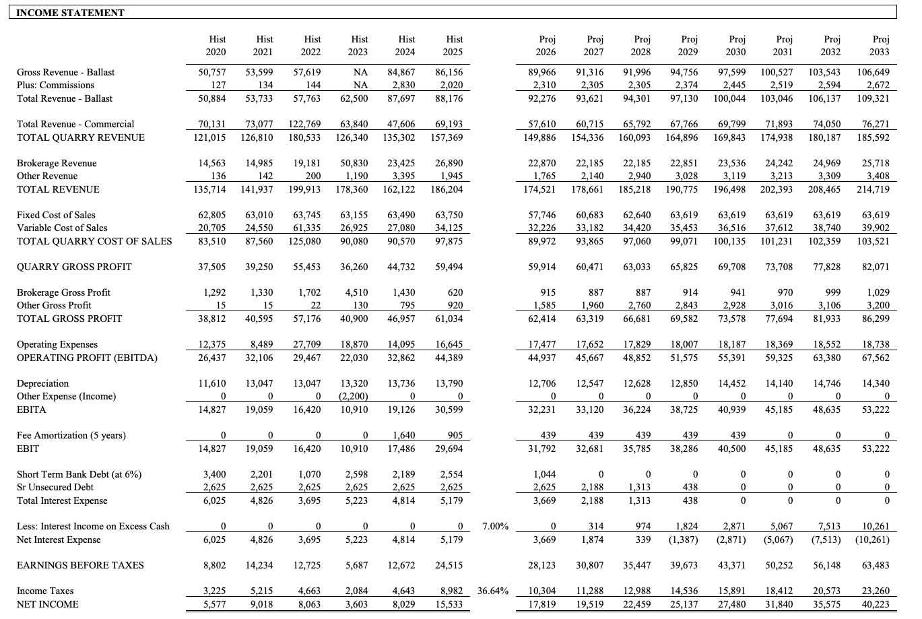

Slide 12
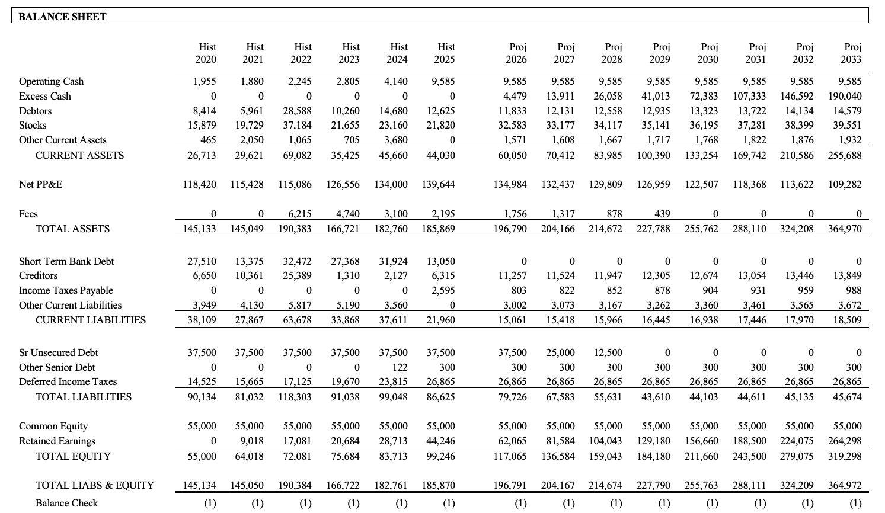

Slide 13
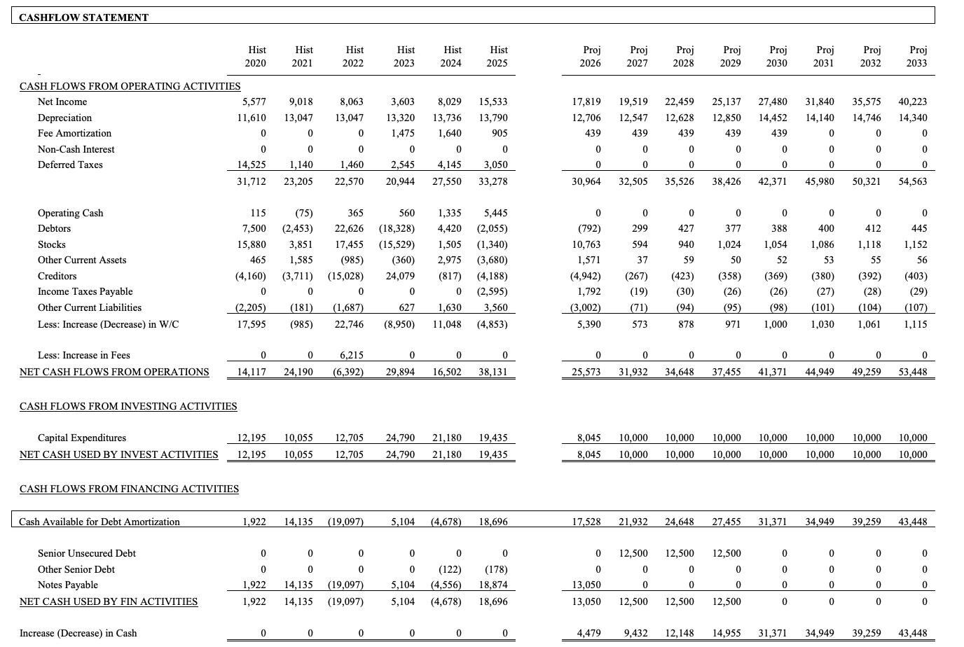

Slide 14
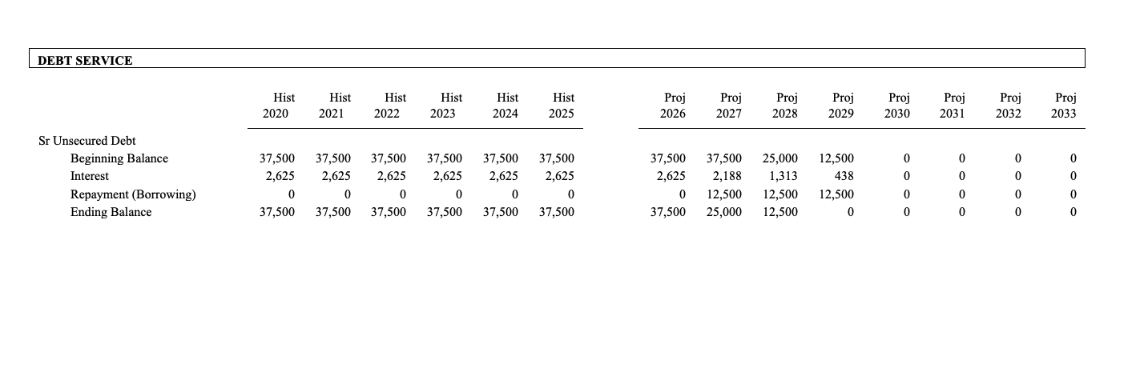
˙

Slide 15
Anglo American Aggregates Industry and Business Risk

Slide 16
Railroad and Commercial Aggregates: Industry Risk

Slide 17
CYCLICALITY IN THE AGGREGATES INDUSTRY
The economic profile of the aggregates industry – whether directed at end user markets for railroads or commercial infrastructure construction - is linked directly to the state of the economy.
THE RAILROAD INDUSTRY
There is limited investment in new railroads or railways. As a result the majority of spending will be aimed at maintenance and replacement. This in turn will be linked directly to the level of usage which in turn is linked to the economic cycle. As a result, the railroad side of the business can be viewed as cyclical.
THE COMMERCIAL AGGREGATE INDUSTRY AND INFRASTRUCTURE SPENDING
By contrast the commercial aggregate business is linked to a combination of infrastructure, airport and highway construction. This in turn is linked to government spending which typically occurs in an economic downturn, making this part of the company’s business counter cyclical.

Slide 18
COST STRUCTURE
As a capital intensive manufacturing company, aggregate manufacturers carry a high proportion of fixed costs relative to their own overall cost structure. This leaves aggregate producers exposed to revenue declines in a cyclical downturn.
CAPITAL INTENSIVE
The mining of aggregates – as in all basic industries such as automotive, steel, and construction – requires heavy and recurring capital reinvestment in order to increase productivity and profitability.
CAPACITY UTILIZATION
Maximizing revenues while minimizing costs in general and fixed costs in particular, as well as the investment in working capital and fixed assets.
COMMODITIZED PRODUCT
The commoditized nature of aggregate products presents challenges of differentiation within competitive markets for producers.
18

Slide 19
ENVIRONMENTAL CONSIDERATIONS
Not only during the life of the quarry does regulatory compliance with environmental guidelines require additional costs, but at the end of the life of the quarry, the quarry will need to be rehabilitated back to the original landscape. While there may be alternative economic uses in such circumstances, the cost of rehabilitation has to be set aside over the remaining life of the quarry.
COMMODITY PRICES
Movements in aggregates prices – as a basic commodity – are beyond the control of individual manufacturers. In addition, companies have limited ability to control important input costs, most notably the cost of mining the raw aggregate.
OTHER INPUT COSTS
In addition to the cost of the raw material, the key input costs in the mining and manufacturing of aggregates are energy, labor, and transportation.

Slide 20
Business Risk Analysis

Slide 21
RAW MATERIAL COSTS
As the owner of at least 8 quarries throughout the U.K., AAA enjoys a cheap source of raw material. Owning the quarries also serves as a natural hedge against rising aggregate prices while providing lenders with a tangible asset carried at cost, which in turn serves as a secondary source of repayment.
EXCELLENT CAPACITY UTILIZATION
Excellent capacity utilization is assured because of the benefit of long term contracts with AAA’s major railroad customers. As a result, AAA has become one of the most efficient producers of aggregate materials in the U.K. in general, and the Midlands and North of England in particular.
GOOD LABOR RELATIONS
By providing profit sharing for the workers, and avoiding unnecessary layoffs, AAA enjoys excellent labor relations across its workforce.

Slide 22
LONG TERM CONTRACTS WITH BARRINGTON NORTHERN AND UNITED PACIFIC
With a combination of long term contracts through the end of 2033, with both Barrington Northern and United Pacific, AAA has assured long term flows of cash. Unfortunately the contracts are “take and pay” contracts, not “take or pay” contracts, meaning that AAA would still be exposed to a cyclical downturn in the event that demand fell off at either of their two railroad customers.
THE BROKERAGE DIVISION AND LOW TRANSPORTATION COSTS
Technically, the brokerage division can source aggregate from any aggregates mine which provides the cheapest and best quality aggregate. This does not mean necessarily that they must source from AAA’s mines. However, given that the mines were originally developed by Barrington Northern and would have been mined close to the railroads, this suggests that AAA will enjoy a competitive transportation cost advantage.

Slide 23
CAPITAL EXPENDITURE PROGRAM
Over the last three years AAA has invested over £65 million in refurbishing the mining facilities at each of its quarries. As a result, AAA in fiscal 2025 has demonstrated a significant increase in gross margin profitability, reaffirming its position as one of the low cost providers in the industry.
ENVIRONMENTAL PROTECTION
With respect to the rehabilitation costs of the quarries which have to be rehabilitated at the end of their life, AAA enjoys a £30 million standby letter of credit provided by Barrington Northern which assumes that the costs of rehabilitation will be borne by Barrington Northern and not by AAA.

Slide 24
Anglo American Aggregates Management’s Agenda

Slide 25
Liquidity vs. Illiquidity
Control vs. be Controlled
Buy vs. Sell
Stay Private vs. Go Public
Strategic Partner vs. Financial Partner
Debt vs. Equity
Grow the Company vs. Consolidate the Company
PV of the Future Cash Flows:
Capitalize New Assets with Debt vs. Recapitalize Equity with Debt

Slide 26
Sell all of part of your shares
Borrow against your shares
Leveraged cash out or dividend recapitalization
Go public
Buy all or part of the shares
Maintain the status quo: do nothing

Slide 27
Financial Buyer Lloyds Private Equity Partners

Slide 28
Lloyds PRIVATE EQUITY PARTNERS: OBJECTIVES AS A FINANCIAL BUYER
Financial buyer with IRR objectives of a minimum of 22%
Will capitalize the acquisition by using senior debt (approximately 50% of the Pro forma Capital Structure on day 1 of the transaction) and subordinated debt (approximately 25% of the Pro forma Capital Structure on day 1 of the transaction), as well as its own private equity
As a financial buyer Lloyds Private Equity Partners will work closely to stay within the ranges of EV/EBITDA multiples for companies in this industry of 5 to 8x, while still respecting P/E multiples for companies in the same sector of 12 to 18x.
Will allow Anglo American Aggregates to maintain independent legal identity with separate Board of Directors and Jake Stone as Chief Executive
Three to five-year investment horizon
Limited to no involvement in day-to-day management

Slide 29
Lloyds PRIVATE EQUITY PARTNERS: OBJECTIVES AS A FINANCIAL BUYER (CONT’D)
Exit strategy will include possible IPO, leveraged recapitalization or, in exceptional circumstances, leveraged buildout strategy with further acquisitions
Will let management manage
Will grant management five year contracts
Knows Anglo American Aggregates through lending relationship
Will allow management the rights to co-invest up to 49% of the common equity in the first instance
Will grant management options providing the potential for management to get control - subject to satisfactory operational performance - at the time of exit
Will respect the BNR contracts in both letter and spirit

Slide 30
Acquisition Analysis
Lloyds Private Equity Partners as Financial Buyer

Slide 31
Debt Capacity
General Principles in Acquisition Financing

Slide 32
DEBT CAPACITY - A DEFINITION
An appropriate way to look at debt capacity is to calculate the present value of cash flows available to service and repay bank debt over an acceptable period of time, assuming no growth.
DEBT CAPACITY - DEFINITION OF CASH FLOW
Usually, for the purposes of debt capacity, this is defined as either (1) EBIDA – replacement or maintenance CAPEX, or (2) tax adjusted operating profit (EBIT*(1-t) plus depreciation and amortization - replacement capital expenditures).
REPLACEMENT OR MAINTENANCE CAPITAL EXPENDITURES
Typically replacement or maintenance capital expenditures refers to that level of reinvestment required to sustain the debt capacity cash flows at their present level. A reasonable proxy for such reinvestment would be the annual depreciation charge.

Slide 33
DISCOUNT RATE
Where EBIDA - replacement CAPEX is used, the discount rate should be the prevailing interest rate cost for the borrower over the five to ten year period.
Where EBIT (1-t) + depreciation and amortization - replacement CAPEX is used the discount rate should be the same as mentioned above but on a tax adjusted basis (i.e. i x (1-t)).
DEBT CAPACITY - TERMINAL VALUE
Typically the cash flows are discounted over five to ten years with a terminal value of zero - banks and even bond holders like to see whether or not they can be fully repaid.
DEBT CAPACITY - PRACTICAL APPLICATIONS
In the following slides, four applications of the model are shown: (1) calculating the debt capacity based upon AAA’s cash flows, (2) the length of time over which the existing debt can be repaid, (3) the sensitivity or breakeven cash flow analysis applied to the company’s cash flows, and, (4) the future value of existing debt at the end of the payout period.

Slide 34
Anglo American Aggregates Debt Capacity: Application in 2025

Slide 35
Using fiscal 2025’s income statement, AAA’s debt capacity could be calculated as follows:
Net Income 15.5
+ Interest 5.2
+ Depreciation 13.8
+ Amortization 0.9
- Replacement CAPEX (10.0)
25.4
EBIDA - Replacement CAPEX = £25.4 million

Slide 36
The Debt Capacity for AAA will therefore be:
25.4 +/- PMT
7 n
6 i
0 FV
PV = £141.8 million
Rounding to senior debt of £142 million / EBITDA in 2025 of £44 million
Senior Debt / EBITDA = 3.2 x - a reasonable multiple for a capital intensive business in a cyclical industry such as aggregates or basic materials.

Slide 37
Anglo American Aggregates Debt Capacity, Capital Structure, and Acquisition Finance

Slide 38
Assuming the senior debt capacity of £142 million, the capital structure could lead to the following Enterprise Value.
Based upon a senior debt to junior capital (subordinated debt + equity) ratio of 1:1 or 50/50, the debt capacity model enables us to back into enterprise value as follows:
Sources
Uses
Senior Debt 142
Short Term Bank Debt 13
Junior Debt + Equity 142
Long Term Debt 38
Equity 233
Enterprise Value 284
Enterprise Value 284

Slide 39
Based upon the comparable multiples in the marketplace for this type of middle market company this value compares favorably:
EV / EBITDA = 284 / 44 = 6.45 times
(vs. comparables in the middle market of 5 to 8 times)
Price / Earnings = 233 / 15.5 = 15 times
(vs. comparable market multiples of 12 to 18 times)

Slide 40
Based upon the equity valuation of £233 million, the percentages required for effecting the various transactions and the pay outs to the various groups of equity holders will be:
15% £34.95 million (Stone’s share)
42.5% £99.025 million (the younger managers’ shares)
42.5% £99.025 million (the older managers’ shares)
2.2% £5.13 million (an individual manager’s share)

Slide 41
With Stone’s shares worth £34.95 million and the younger managers’ shares worth £99.025 million, a purchase price of £284 million could be financed as follows:
Senior Debt: £142 million
Sub Debt: £70 million
Equity: £72 million
As a result of which, Stone and the managers will invest 49% of the £72 million required from the £233 million proceeds . . . .

Slide 42
…..and roll this equivalent – or £35 million – into the new equity structure, with the remaining 51% - or £37 million - being provided in cash by the private equity firm as follows……
Sources
Uses
7- Year Term Loan 142
Short Term Bank Debt 13
Mezzanine/Sub Debt 70
Long Term Debt 38
Manager’s Equity (49%) 35
Equity 233
Private Equity (51%) 37
Enterprise Value 284
Enterprise Value 284

Slide 43
One of the best ways to corroborate the purchase price is to examine the likely IRRs on the investment.
This can be done by “guesstimating” the value of the firm in, say, 5 years time (2030) - the likely investment time horizon for the financial sponsors.
Today’s EV / EBITDA = 284 / 44 = 6.45 times
2030’s EBITDA of £55.4 million x 6.45 =
2030’s Enterprise Value of £358 million

Slide 44
Anglo American Aggregates Acquisition Financing and IRR Analysis

Slide 45
From 2030’s Enterprise Value of £358 million, we must subtract the “guesstimated” outstanding senior and subordinated debt at that time.
Senior debt outstanding can be determined by the following:
142 PV (Senior Debt Outstanding on Day 1)
5 n (5 year investment horizon)
6 i (senior debt interest rate)
25.4 +/- PMT (EBIDA Debt Capacity Cash Flows)
FV -46.85 (Senior Debt Outstanding in Year 5)

Slide 46
In 2030 the outstanding capital will therefore be as follows:
Enterprise Value £358 million
Mezz/Sub-Debt Outstanding (£70 million)
Senior Debt Outstanding (£47 million)
Equity Value in 2030 £241 million

Slide 47
Based upon the original £72 million equity investment in 2026, the IRRs for the equity holders will be:
72 +/- PV (Original equity investment on day 1)
5 n (5 year investment horizon)
241 FV (Equity value in year 5)
0 PMT (No dividend payments)
i 27.33 (IRR on original investment)*
*In solving for i with the Texas Instruments BAII remember to hit CPT before the i

Slide 48
For AAA the valuation at £284 million has been validated from a number of perspectives:
At 6.45 times EBITDA it is in the range of 5 to 8 times for comparable deals
At 15 times Price/Earnings it is in the range for comparable publicly traded stocks in this industry of 12 to 18x
With a debt capacity of 3.2 times EBITDA it is a financeable senior debt deal
With IRR’s of just over 27% for the management and the private equity investors, this is an attractive deal in terms of target returns
Of their combined £233 million of equity proceeds, Jake and the managers still take out £198 million in cash today prior to reinvesting £35 million

Slide 49
Anglo American Aggregates
The Deal Structure

Slide 50
Leveraged or Management Buyout in conjunction with Lloyds Private Equity Partners as a Private Equity Investor
Lloyds Private
Equity Partners
Management
49%
51%
SPV or
Holding Co.
Barclays
as Lender
£ Loan
100%
Pledge of Shares
AAA
Guarantee
Pledge of Assets

Slide 51
Immediately following the transaction the SPV will merge into AAA with AAA as the surviving entity. As a result the shareholding and loan structure will be as follows:
Lloyds Private
Equity Partners
Management
51%
AAA
49%
£ Loan
Barclays
as Lender
Pledge of Assets

Slide 52
Lloyds Private Equity Partners Discounted Cash Flow Valuation

Slide 53
Free Cash Flow
The EBIT (1-t) Approach

Slide 54
TV
2030
40,500
25,661
14,452
(14,452)
-
25,661
2026
31,792
20,143
12,706
(8,045)
(5,390)
19,414
2027
32,681
20,707
12,547
(10,000)
(573)
22,681
2028
35,785
22,673
12,628
(10,000)
(878)
24,423
2029
38,286
24,258
12,850
(10,000)
(971)
26,137
2030
40,500
25,661
14,452
(10,000)
(1,000)
29,113
EBIT
EBIT (1-t)*
+ Depreciation
- Capital Expenditures
+/- Change in NWC
Free Cash Flow
* EBIT (1-t) is based upon an effective tax rate of 36.64%.
Notes:
Page 22 (2)

Slide 55
Discounted Cash Flow
Step 2: Weighted Average Cost of Capital

Slide 56
Using the 2025 Anglo American Aggregates Balance Sheet as a proxy for the optimal market value balance of the Company’s Capital Structure, the WACC of 9.60% is computed as follows:
Capital Component
Weight
Pre-Tax
Cost After Tax at 36.64%
Weighted Cost
Senior Debt
50%
6.0%
4.40%
2.20%
Mezz Debt
25%
12.0%
7.60%
1.90%
Equity
25%
22.0%
22.0%
5.50%
Total
100.00%
9.60%
Notes:
Page 25

Slide 57
Discounted Cash Flow
Step 3: Terminal Value

Slide 58
TERMINAL VALUE: REGULAR PERPETUITY METHOD
Based upon the fact that the time horizon for the investment period for most financial buyers is five years, it is more common to use the regular perpetuity method for determining the terminal value.
TERMINAL VALUE: AAA ASSUMPTIONS
The adjusted normalized EBIT (1-t) for 2030 as the basis for perpetual cash flows would be £25,661. This should then be discounted at the WACC for Lloyds Private Equity Partners in this investment of 9.60%.
TERMINAL VALUE: THE CALCULATION
£ 25,661
£ 267,302
=
.0960

Slide 59
Discounted Cash Flow
Step 4: Pulling the Steps Together

Slide 60
Using the HP-10B calculator the Enterprise Value for Anglo American Aggregates using the Regular Perpetuity approach would be calculated as follows:
0 CFJ
19,414 CFJ
22,681 CFJ
24,423 CFJ
26,137 CFJ
29,113 + 267,302 = CFJ
9.60 I/Yr
Shift* NPV 260,693
*The shift key is the orange key in the first column, sixth row, of the calculator
Notes:
Page 33 (1) remember asterisk

Slide 61
Using the HP-12C calculator the Enterprise Value based upon the Terminal Value calculated using the Regular Perpetuity Approach for AAA would be calculated as follows:
- f CLX
0 g CFO
19,414 g CFJ
22,681 g CFJ
24,423 g CFJ
26,137 g CFJ
29,113 Enter 267,302 + g CFJ
9.60 i
f NPV 260,693
Notes:
Page 32 (1)

Slide 62
Using the BAII Texas Instruments calculator the Enterprise Value based upon the Terminal Value calculated using the Regular Perpetuity Approach for AAA would be calculated as follows:
CF
0 Enter
19,414 Enter
1 Enter
22,681 Enter
1 Enter
24,423 Enter
1 Enter
26,137 Enter
1 Enter
29,113 + 267,302 = Enter
1 Enter
NPV 9.60 Enter
CPT
260,693
Notes:
Page 35 remember asterisk

Slide 63
ENTERPRISE VALUE : EBITDA MULTIPLES
Validation of the Enterprise Value is arrived at by looking at the Enterprise Value as a multiple of EBITDA and comparing this multiple to that of other companies in the same industry.
AAA therefore has a 5.87x EV/EBITDA multiple derived as follows: £260,693 / £44,389 (2025's EBITDA).
This multiple is in the mid-range of 5-8x EV/EBITDA for companies in this industry.

Slide 64
EQUITY VALUE: PRICE EARNINGS MULTIPLES
To arrive at AAA’s Equity Value, AAA’s Net Debt (Short Term Bank Debt (STD) + Long Term Debt (LTD) - Cash) is subtracted from the Enterprise Value as follows:
£260,693 – £13,050 (STD) – £37,800 (LTD) + £9,585 (Cash) = £219,428
The value of the equity based on a Price/Earnings multiple is therefore:
219,428/15,533 or 14.12x.
At 14.12x this Price/Earnings multiple is in the mid-range for publicly traded companies in this industry of 12-18x.

Slide 65
For AAA the discounted cash flow valuation at £261 million has been validated from a number of perspectives:
At 5.87x EBITDA it is in the range of 5 to 8x for comparable deals
At 14.1x Price/Earnings it is in the range for comparable publicly traded stocks in this industry of 12 to 18x
Finally, the price compares quite closely with the EV/EBITDA multiple of 6.45x arrived at by using the Debt Capacity approach and derived multiples of Senior Debt/EBITDA.

Slide 66
Strategic Buyer Hanson Trust

Slide 67
HANSON TRUST: OBJECTIVES AS A STRATEGIC BUYER
£5 billion in revenues make it the largest building supplies manufacturer in the U.K.
Does not know Anglo American Aggregates
Cash purchaser, but is also prepared to use its own publicly traded stock
In determining the Capital Structure on day 1, Hanson typically finances its acquisitions in line with its global target corporate structure of 50% debt/50% equity
Based upon a risk free rate of 5%, a market risk premium of 5%, and Hanson’s existing beta of 1.5, Hanson’s typical cost of equity used in acquisition financing is 12.5% (5% + (5% x 1.5))
Hanson’s existing Price/Earnings multiple is 16.5x (at the higher end of the range which typically runs up to 18x), and when making acquisitions, Hanson typically pays multiples of 6 to 8 x EV/EBITDA for companies in this sector

Slide 68
HANSON TRUST: OBJECTIVES AS A STRATEGIC BUYER
AAA will become a division of a group subsidiary and will lose its corporate identity
Hanson’s goal on its investments is just to recover its own 8% cost of capital
No management contracts - only the fit survive
Younger managers have an opportunity for aggressive advancement
When calculating the terminal value, Hanson typically uses growing perpetuity formula and applies a terminal year’s growth rate of 2%
Will respect the letter of the BNR contracts, but not necessarily the spirit - clearly wants the granite for its own long term construction objectives
It just wants the rocks!!

Slide 69
Acquisition Analysis
Hanson Trust as Strategic Buyer

Slide 70
Hanson Trust Discounted Cash Flow Valuation

Slide 71
Free Cash Flow
The EBIT (1-t) Approach

Slide 72
TV
2030
40,500
25,661
14,452
(14,452)
-
25,661
2026
31,792
20,143
12,706
(8,045)
(5,390)
19,414
2027
32,681
20,707
12,547
(10,000)
(573)
22,681
2028
35,785
22,673
12,628
(10,000)
(878)
24,423
2029
38,286
24,258
12,850
(10,000)
(971)
26,137
2030
40,500
25,661
14,452
(10,000)
(1,000)
29,113
EBIT
EBIT (1-t)*
+ Depreciation
- Capital Expenditures
+/- Change in NWC
Free Cash Flow
* EBIT (1-t) is based upon an effective tax rate of 36.64%.
Notes:
Page 22 (2)

Slide 73
Discounted Cash Flow
Step 2: Weighted Average Cost of Capital

Slide 74
Using the optimal target Capital Structure favored by Hanson for its corporate investments of a 50% Debt/50% Equity Capital Structure, the WACC of 8.45% is computed as follows:
Capital Component
Weight
Pre-Tax
Cost After Tax at 36.64%
Weighted Cost
Senior Debt
50%
6.0%
4.40%
2.20%
Equity
50%
12.5%*
12.5%
6.25%
Total
100.00%
8.45%
*Cost of Equity: 5% + (5% x 1.5) = 12.5%
Notes:
Page 25

Slide 75
Discounted Cash Flow
Step 3: Terminal Value

Slide 76
TERMINAL VALUE: GROWING PERPETUITY METHOD
Based upon the fact that the time horizon for the investment period for most buyers in determining terminal value is five years, the terminal value will be calculated using the normalized 2030 EBIT (1-t), and assuming a 2% perpetual growth rate.
TERMINAL VALUE: AAA ASSUMPTIONS
The adjusted normalized EBIT (1-t) for 2030 as the basis for perpetual cash flows would be £25,661. This should then be discounted at the WACC for Hanson for this investment of 8.45%, which in turn should be reduced by the implied growth rate of 2%.
TERMINAL VALUE: THE CALCULATION
£ 25,661
£ 397,845
=
.0845 - .02

Slide 77
Discounted Cash Flow
Step 4: Pulling the Steps Together

Slide 78
Using the HP-10B calculator the Enterprise Value for Anglo American Aggregates, using the Regular Perpetuity Approach, but with a lower WACC for the Terminal Value and discounting of free cash flows, would be calculated as follows:
0 CFJ
19,414 CFJ
22,681 CFJ
24,423 CFJ
26,137 CFJ
29,113 + 397,845 = CFJ
8.45 I/Yr
Shift* NPV 359,829
*The shift key is the orange key in the first column, sixth row, of the calculator
Notes:
Page 33 (1) remember asterisk

Slide 79
Using the HP-12C the Enterprise Value for Anglo American Aggregates, using the Regular Perpetuity Approach, but with a lower WACC for the Terminal Value and discounting of free cash flows, would be calculated as follows:
- f CLX
0 g CFO
19,414 g CFJ
22,681 g CFJ
24,423 g CFJ
26,137 g CFJ
29,113 Enter 397,845 + g CFJ
8.45 i
f NPV 359,829
Notes:
Page 32 (1)

Slide 80
Using the BAII Texas Instruments calculator the Enterprise Value for Anglo American Aggregates, using the Regular Perpetuity Approach, but with a lower WACC for the Terminal Value and discounting free cash flows, would be calculated as follows:
CF
0 Enter
19,414 Enter
1 Enter
22,681 Enter
1 Enter
24,423 Enter
1 Enter
26,137 Enter
1 Enter
29,113 + 397,845 = Enter
1 Enter
NPV 8.45 Enter
CPT
359,829
Notes:
Page 35 remember asterisk

Slide 81
Hanson Trust Capital Structure and Acquisition Finance

Slide 82
Assuming that Hanson will finance the deal with either cash or its own stock, the sources and uses for the transaction would appear as follows:
Sources
Uses
Cash or Stock 360
Short Term Bank Debt 13
Long Term Debt 38
Equity 319
Enterprise Value 360
Enterprise Value 360

Slide 83
ENTERPRISE VALUE : EBITDA MULTIPLES
Validation of the Enterprise Value is arrived at by looking at the Enterprise Value as a multiple of EBITDA and comparing this multiple to that of other companies in the same industry.
AAA therefore has an 8.11x EV/EBITDA multiple derived as follows: £359,829 / £44,389 (2025's EBITDA).
This multiple is at the highest end of the range of EV/EBITDA multiples which Hanson typically pays for companies in this industry of 6-8x EBITDA.

Slide 84
EQUITY VALUE: PRICE EARNINGS MULTIPLES
To arrive at AAA’s Equity Value, AAA’s Net Debt (Short Term Bank Debt (STD) + Long Term Debt (LTD) - Cash) is subtracted from the Enterprise Value as follows:
£359,829 – £13,050 (STD) – £37,800 (LTD) + £9,585 (Cash) = £318,564
The value of the equity based on a Price/Earnings multiple is therefore:
318,564/15,533 or 20.5x.
At 20.5x this Price/Earnings multiple is higher than every company presently in this industry where the range for publicly traded companies is 12-18x.

Slide 85
For AAA the valuation at £360 million would be at the highest end of the range which would raise challenges for Hanson with its existing shareholders:
At 8.11 times EBITDA it is higher than the highest limit of 8x typically paid by Hanson, and the more typical range of 5-8x EBITDA
At 20.5x Price/Earnings it is conspicuously above the highest end of the range for comparable publicly traded stocks in this industry of 12 to 18x

Slide 86
Jake Stone and the Team
The Choice

Slide 87
If you were Jake Stone with the casting vote between the older and the younger managers, which of the two buyers would you select?
(A) Lloyds Private Equity Partners
Let us assume that Lloyds Private Equity Partners is comfortable paying £284 million for the company (based upon the Debt Capacity approach to Valuation) – slightly higher than the DCF Valuation approach of £261 million.
Management would therefore receive £233 million today (compared to the £219 million under the DCF valuation).
Management would then reinvest £35 million today, and retain £198 million in cash. In addition, the right to reinvest 49% in the company today will provide Management with the chance to increase their shareholding to control when Lloyds Private Equity Partners sells in five years time.

Slide 88
Alternatively, if you were Jake Stone with the casting vote between the older and the younger managers, would you consider the following?
(B) Hanson Trust
Selling the company for £360 million in cash.
Management would receive £319 million in cash today.
However, Management would have no say in the future of the company, nor any long term upside since Management will have forgone the right to co-invest in the company.

Slide 89
Appendix 1
Use of Excel (WACC of 9.60%)
Anglo American Aggregates

Slide 90
Open a blank workbook in Excel, go to the top ribbon and select “Formulas”
*Note, this was done on Excel for Mac. While it may look different from Excel on Windows, the principles remain the same.

Slide 91
Under Formulas, select “Financial”

Slide 92
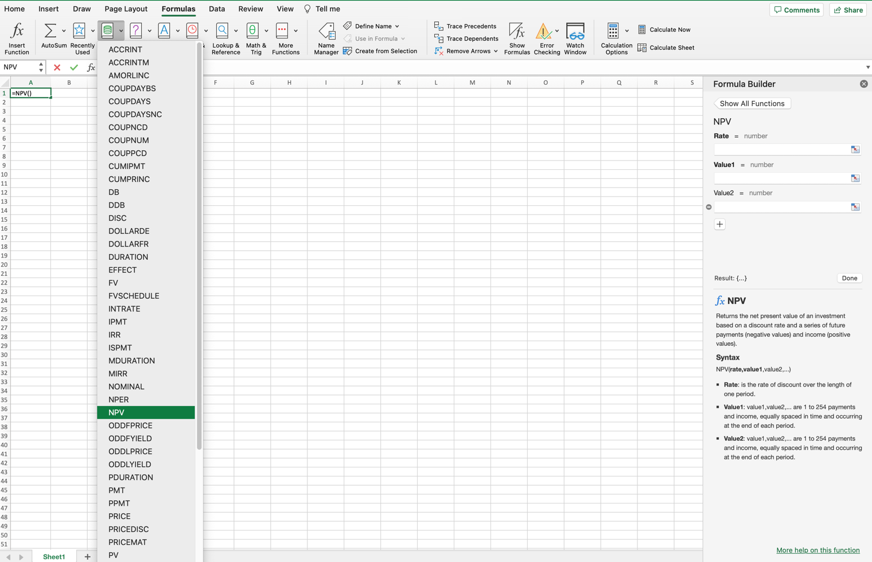
A drop-down menu will open that you can use to select your calculation

Slide 93
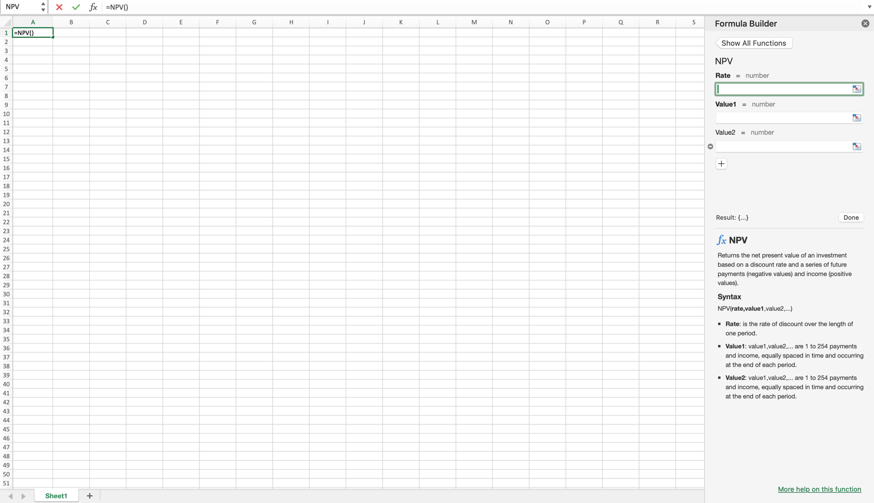

Slide 94
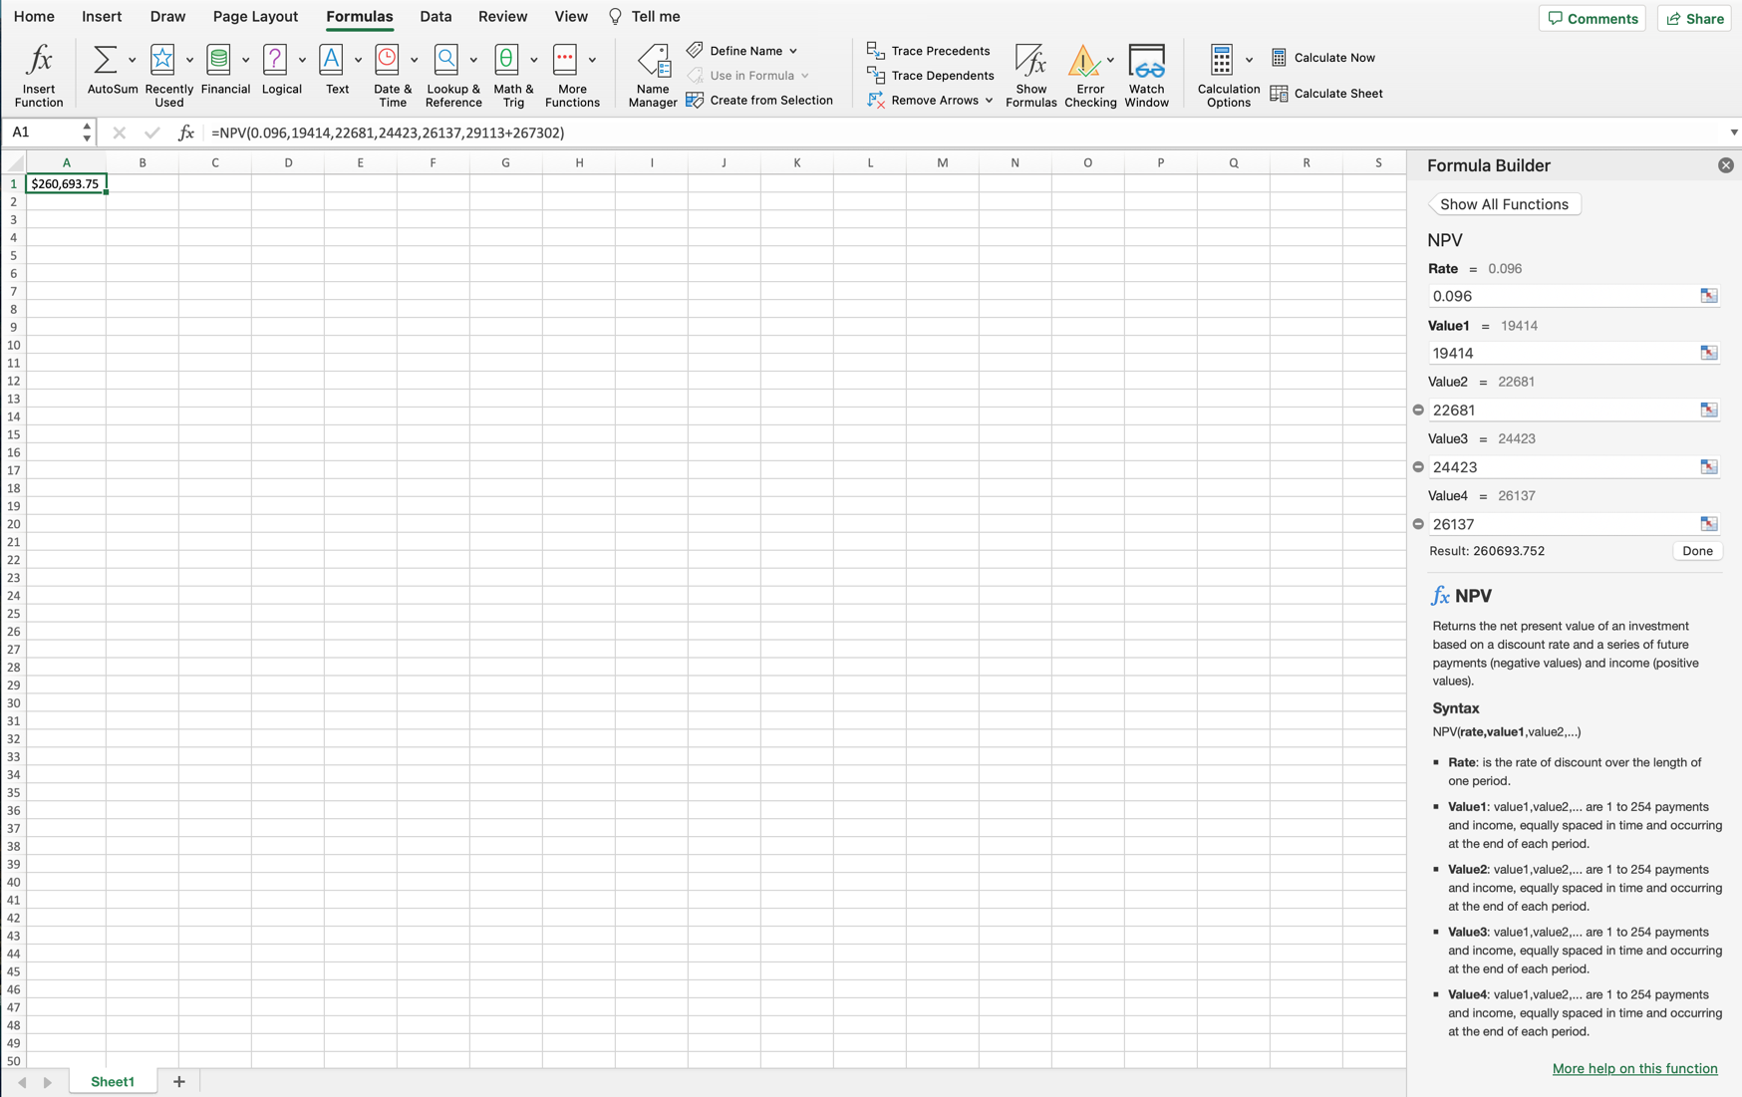
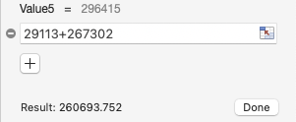

Slide 95
Appendix 2
Use of Excel (WACC of 8.45%)
Anglo American Aggregates

Slide 96
Open a blank workbook in Excel, go to the top ribbon and select “Formulas”
*Note, this was done on Excel for Mac. While it may look different from Excel on Windows, the principles remain the same.

Slide 97
Under Formulas, select “Financial”

Slide 98
A drop-down menu will open that you can use to select your calculation

Slide 100
